Slide 1

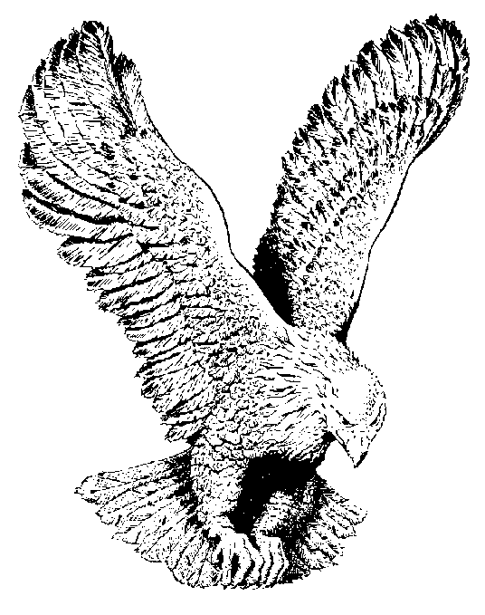
343
VICTORY AHEAD
When the host of isreal, led by God,
Round the walls of Jericho softly’ trod;
Trusting in the Lord, they felt the conq’ror’s tread’
By faith they saw the victory ahead.

Slide 2
CHORUS:
Victory ahead! Victory ahead!
Thru the blood of Jesus, Victory ahead;
Trusting in the Lord, I hear the conq’ror’s tread,
By faith I see the victory ahead.

Slide 3
David with a shepherd’s sling and five stones,
Met the giant on the field all alone;
Trusting in the Lord, he knew what God had said,
By faith he saw the victory ahead.

Slide 4
Daniel prayed unto the Lord thrice each day,
Then unto the lion’s den led the way,
Trusting in the Lord, he did not fear or dread,
By faith he saw the victory ahead.

Slide 5
Often with the carnal mind I was tried,
Asking for deliverance I cried,
Trusting in the Lord, I reckoned I was dead,
By faith I see the victory ahead.

Slide 6
When like those who’ve gone before to that land,
By death’s river cold and dark I shall stand;
Trusting in the Lord, I will not fear or dread,
By faith I see the victory ahead.

